Slide 1

Kenny Song, NYU Abu Dhabi
Nael hailemariam, Beihang university
Game of code 2016

Slide 2
The Problem
1. Where is the closest available parking lot to you right now?
2. Where can you park your car tomorrow, over the weekend, or this evening?

Slide 3
The Solution
ParkLux tracks the status of Luxembourg City’s parking lots in real-time and historically.
It can tell you the closest available spot to park your car, as well as the # of open spots in every parking lot in the city.
It can also tell you where and when to park your car later by looking at historical data.

Slide 4
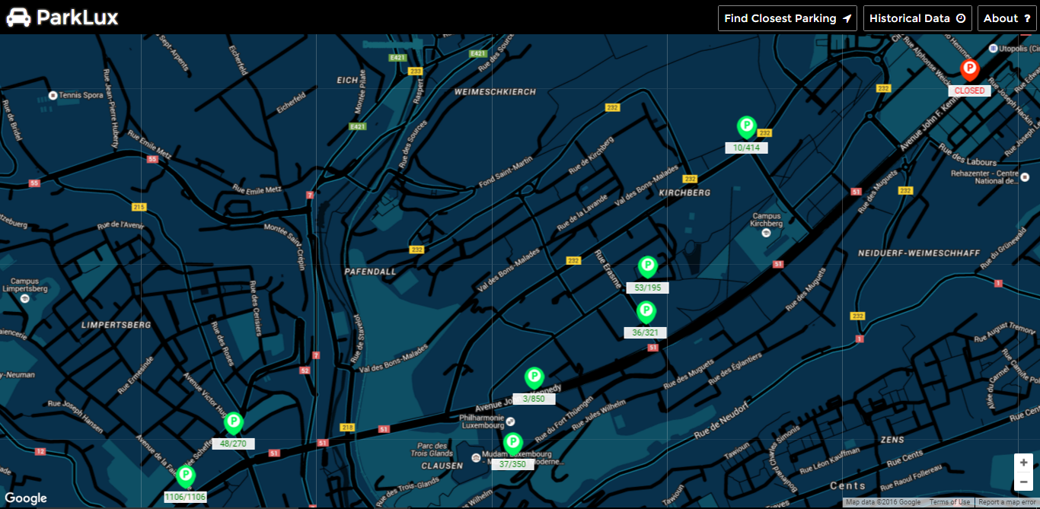
Data taken at 4:01 PM, 09/APRIL/2016

Slide 5
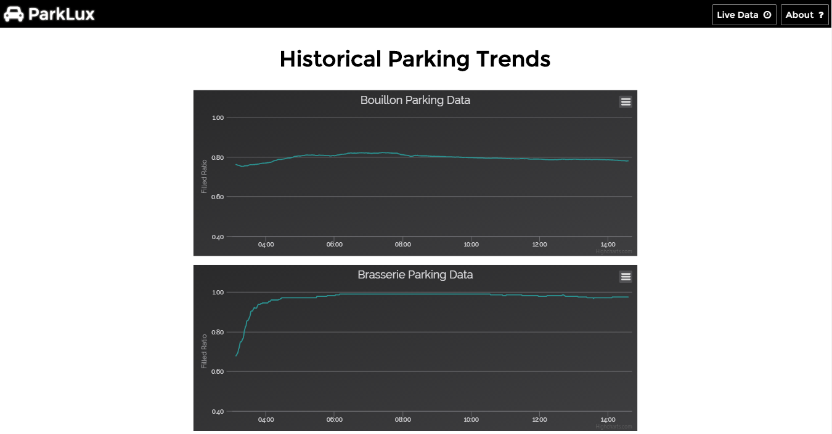
Data taken at 4:05 PM, 09/APRIL/2016

Slide 6
Technical Overview
Flask server running on Microsoft Azure
Data is stored and streamed in real-time with Firebase
Google Maps API and HighCharts provides core front-end functionality

Slide 7
Live Demo
https://parklux.azurewebsites.net

Slide 8

Any Q?

